Slide 1
SOFTWARE PROJECT MANAGEMENT AND COST ESTIMATION

Slide 2
Communication
Training
Intercommunication
Effort increases as:
n(n – 1)/2
3 workers require three times as much pair-wise intercommunication as 2; 4 workers need 6 times as much as 2.
Notes:
Communication is in two parts: training and intercommunications
Training is required: in the technology, the goals of the project, the overall strategy and the plan of work. Training cannot be partitioned each new man must go through it individually.
Intercommunication is required in more complex tasks such as software engineering. It assumes that to complete the task workers must have pairwise communications.
If each part of the task must be separately co-ordinated with every other part the effort required increases in a complex way.
Software construction is inherently a team effort and the communication time required is one that cannot be ignored and quickly dominates any partitioning strategy and project costing.

Slide 3
Improving communication
Use hubs to cut down communication overhead
Examples
Specification/design documentation
WiKi
Development meetings
For all these the communication overhead goes up as N not N^2

Slide 4
Brooks Experience
1/3 planning
1/6 coding
1/4 component and prototype testing
1/4 system test (all components in hand)
Notes:
The first question is what are we guessing at … well it’s time. More particularly, it is time to write some standard number of lines of code, or some function (as a subroutine or sub-process). This is fearsomely complicated because it involves target language, methodology, skills involved, learning required, etc. etc.
Another problem is, what is the goal. Is it the completed prototype?, the alpha release (alpha-1 is considered the first field testable version), or the beta release (beta-1 is the first released version).
Brooks, in MMM presents his rules of thumb for scheduling a software task as about half on debugging of completed code and about 1/6 on coding (the bit which is easiest to estimate).
Planning is given 1/3 of the total time, however, he notes that this does not include research time or exploration of new techniques. Where the learning curve is steep (e.g. in honours projects ? This part can consume more than 50% of the time and lead to nothing being delivered …)
The other key point of experience is that failure to allow enough time for testing is particularly disastrous. Because, this comes at the end of the schedule near the delivery milestone, slippage affects customers and badly reflects on the project as a whole.
We thus see the tricky balance between design at the beginning taking too much time – and full system testing at the end.

Slide 5
Brookes law
"Adding manpower to a late software project makes it later."
Exceptions
Applies to projects late already only
Using modern development techniques reduces communications overhead:
Continuous integration, test first design, design patterns
Highly decoupled projects with clear modular specifications

Slide 6
Experience/techniques for smaller projects
Rudy Rucker teaches software engineering computer games at SJSU
He advises
Estimate how long planning will take
Multiply that time by 3
Use the “Inventer Lifecyle” to generate an Alpha 1 by ~½ way through the project
Notes:
Rudy Rucker (San Jose State University) graduate level course. His book (“Software engineering and computer games”, 2003, Addison-Wesley Pearson Education Ltd) is a good one if: a) you are a student; b) you are embarking on a software project to be completed with about 2-3 man months of effort (i.e. roughly an honours project); c) you are planning to write software games.
Rucker develops Brooks idea of using a 1/3 of the time for planning, by suggesting that planning the architecture (essentially the user interface – which we will return to later in the module) should be the goal. He notes that time spent on good architecture will save time in coding and debugging.
He also suggests not doing the waterfall thing, nor really the spiral thing, but a much more concrete thing based on producing small field releases until a final design and feature freeze can happen.
The calls this the “Inventor Lifecyle” … but note this is for students on short 1 to 4 man projects.

Slide 7
Inventor Lifecyle (one/two person projects)
Requirements gathering
Architecture
Specification N and detailed design N
Alpha N program and User Guide
Final design and feature freeze
Beta N program and User Guide
Testing and debugging beta N
Final version and product ship
Rucker (2003) p39
COMP319 Software Engineering II

Slide 8
Cost Estimation Research
100s of papers since the 1960s
As development techniques improve e.g. OO, cost estimation has to adapt
Move from
Coding estimation
Move to
Functional estimation

Slide 9
Cost estimation approaches
Expert estimation
Planning poker
WBS
Formal estimation
COCOMO
Combined methods
Each formal estimation technique has a expert phase anyway

Slide 10
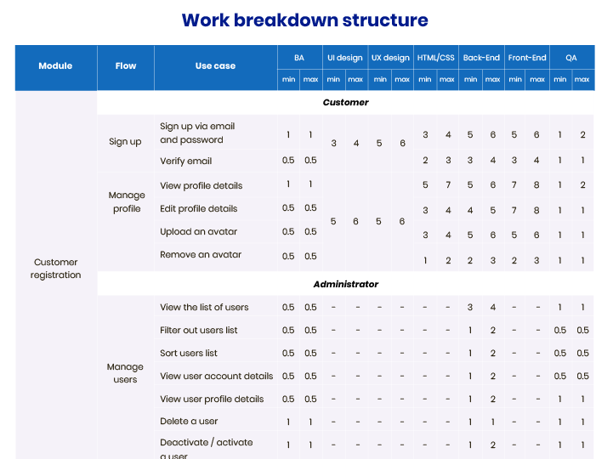

Slide 11
Planning poker (defined and named by James Grenning in 2002)
Each member of planning team given pack of cards with numbers on
Project manager introduces project
Team clarifies assumptions
Discuss risk
Each member picks a card as estimate
Lowest and highest estimation members given change to justify decision
Discuss, then go back to 3, until consensus reached

Slide 12
Planning poker benefits
Reduces anchoring
Low anchor
“"I think this is an easy job, I can't see it taking longer than a couple of weeks”
High anchor
“I think we need to be very careful, clearing up the issues we've had in the back end could take months”
Studies
Molokken-Ostvold, K. Haugen, N.C.
Notes:
Molokken-Ostvold, K. Haugen, N.C. (13 April 2007). "Combining Estimates with Planning Poker--An Empirical Study". IEEE
This showed the planning poker technique produced estimates were less optimistic and more accurate than estimates obtained through other approaches such as mechanical combination of individual estimates for the same tasks.

Slide 13
Software productivity metrics
Measures of size
Lines of (source) code per person month: (LOC/pm)
Object code instructions
Document pages
Measure of function
Function points
Object points

Slide 14
Lines of code (KLOC)
Easy to measure
Difficult to estimate
As productivity measure?
Code quality
Project delivery
Language dependency

Slide 15
Estimating lines of code
Structural decompose project into separate modules
Get programmer to produce 3 figures for each module
pessimistic estimate of LOC for module
average estimate of LOC for module
optimistic estimate of LOC for module
Use weighting factor based on previous estimation performance

Slide 16
System Development times
 | Analysis | Design | Coding | Testing | Documentation
Assembly code | 3 | 5 | 8 | 10 | 2
High level language | 3 | 5 | 4 | 6 | 2
 | Size | Effort | Productivity
Assembly code | 5000 lines | 28 weeks | 714 lines/month
High level language | 1500 lines | 20 weeks | 300 lines/month

Slide 17
Function points
Measuring application development productivity, Alan Albrecht IBM
Application, inputs, processes, outputs
Estimates of the program feature elements
External input and output (transactions)
Users
Other systems (input)
Data
External
Internal

Slide 18
Function point
Application
Internal logic files
Screens
Printers
File output (pdf export)
External inqueries
External output
External input
Other application
External interface file

Slide 19
Function point analysis
Internal logic file
tables in a relational database
Xml files used in application
Complexity : record types (table), data element types, table col (e.g. surname, post code)
External interface file
Same as ILF but not maintained by application
External input (stateful)
Usually user input screen
Purpose to update ILF or change system behaviour
e.g. register new user use case, login
Complexity : data element types and file type referenced (e.g. count of tables updated)

Slide 20
Function point analysis
External outputs (can be stateful)
Data presented to the user
Must : involve some mathematics or derived data obtained or ILF or system behaviour updated
Example produce sales report in PDF file format
Complexity measure:
data element types and file type referenced (e.g. count of tables updated)
External inquires (not stateful)
Data presented to the user
No maths or derived data involved no updates to ILFs
Complexity measure : see external output
Example.. Search for available hotels

Slide 21
Calculating Function points
x Weighting factor
Simple
Average
Complex
External
input count
3
4
6
External
output count
4
5
7
Inquiries
3
4
6
Number of
Internal logical files
7
10
15
External
Interface files
5
7
10
Count total
3SFE519 S Coope 2004
slide 21

Slide 22
Function point estimation including the value adjustment factor (VAF)
FP = count-total x (0.65 + 0.01 ∑Fi)
F1 = Reliable backup and recovery (1-5)
F2 = Data communications (1-5)
F3 = Distributed functions (1-5)
F4 = Performance (1-5)
F5 = Heavily used configuration (1-5)
F6 = Online data entry (1-5)
F7 = Operational ease (UI) (1-5)
F8 = Master file updated online (1-5)
F9 = Complex interface (1-5)
F10 = Complex processing (1-5)
F11 = Reusability (1-5)
F12 = Installation included (1-5)
F13 = Multiple sites (1-5)
F14 = Facilitate change (1-5)
Notes:
Note this is often not used. The VAF will adjust the raw FP count by a factor of about 2 either way. In general function point tool use the raw FP count. From devdaily.com/FunctionPoints
“I can't tell you much about the history of the VAF, but what I can tell from the conversations I've had with many other users is that they don't use the VAF. This stems from at least two reasons that I can determine:
Most users count function points to derive a number that they can plug into another piece of software to determine a cost estimate. Those other software applications usually have their own equivalent of the VAF, and in fact, instruct you to supply the ``raw FP count''. So, in this case, the VAF competes against these vendor tools.
Some users don't feel that the GSCs are flexible enough. I tend to agree, and I think it's an easy argument. When you look at the math below, you'll see that for two applications under consideration, if both start with the same function point count - let's say 1,000 FPs - after adjustments the hardest application in the world would be rated at 1,350 FPs, and the easiest possible application would be rated at 650 FPs when adjusted. Let's say the hardest application in the world had to run on 10 different operating systems in 15 languages and be distributed electronically to 1 million users, and the easiest would be written in Microsoft Access, run on Windows, and be used by only one user, the author of the program. Do you really think the first application is only about twice as hard to deliver as the second? No, I certainly don't, and this is why I don't use the VAF.”

Slide 23
FP issues
Very focused on information style systems
No focus on algorithm complexity, just data
Not applicable for
Complex UI e.g. games
Difficult problems such as AI
No focus on code re-use, assumes size of coding problem defined by complexity of product

Slide 24
Summary
Cost estimation is an important part of managing a project
Cost estimation is a critical financial input for any organisation, e.g. production of contracts
Cost estimation commonly relies on the expertise of the developer to produce correct results (e.g. poker planning or WBS)

